Slide 1
Distributions in Machine Learning
Normal
Binomial
Poison

Slide 2
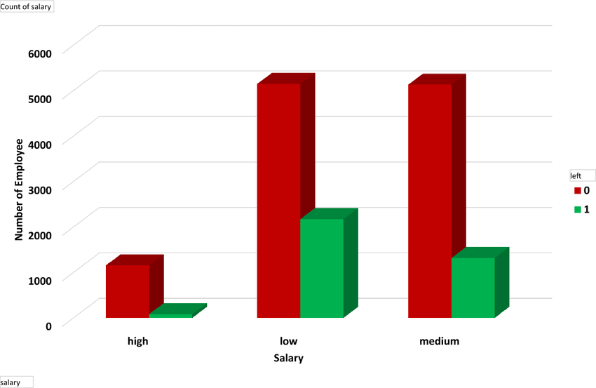
Why Distributions Matter in Machine Learning?
Age | Gender | Salary | Class
50 | Male | High | Stay
30 | Female | Media | Stay
64 | Male | Low | Left
43 | Female | High | Stay
Supervised
Model
How many customer left or stayed
base on their salary level?

Slide 3
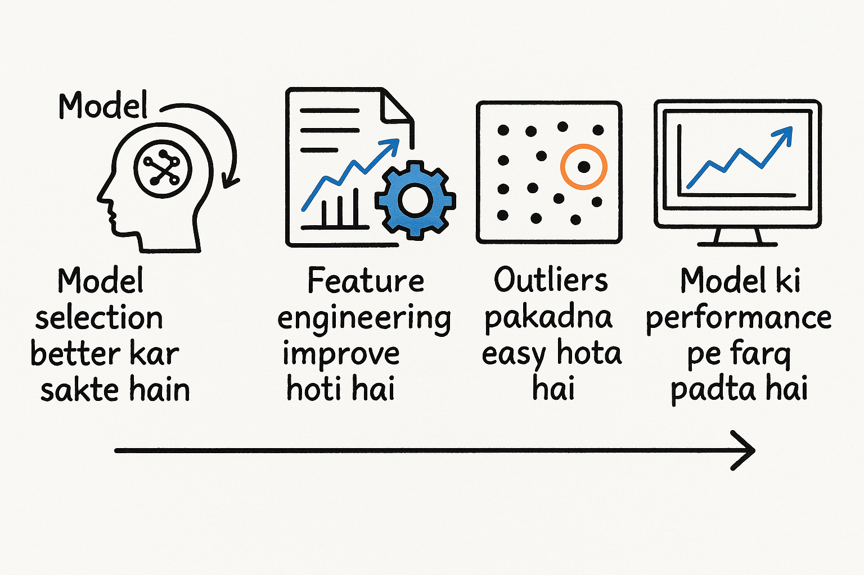
Why Distributions Matter in Machine Learning?
Distribution means, where fall data, and which value is most frequent
If you do distribution,
You will select best model.
Feature engineering will be improved.
Outliers' detection will be easy
Model performance will be improved.

Slide 4
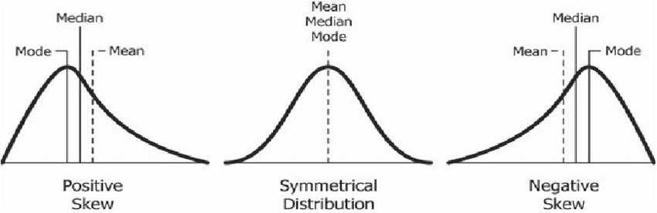
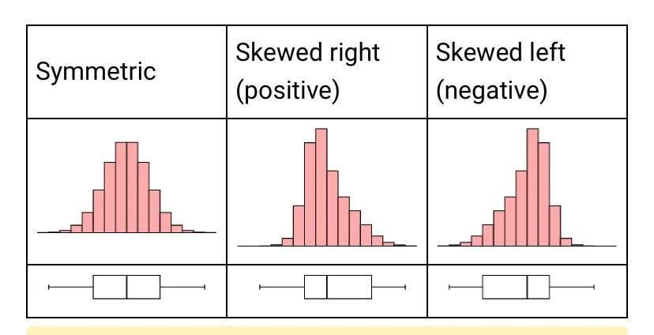

Slide 5
Discrete vs Continuous data
Feature | Discrete Data | Continuous Data
Definition | Countable, specific values | Measurable, any value in a range
Example Variable | Number of students in class | Height of a student
Example Values | 0, 1, 2, 3 | 160.2, 170.5, 180.75
Can be fractional? | ❌ No | ✅ Yes
Measurement Type | Count | Measure

Slide 6
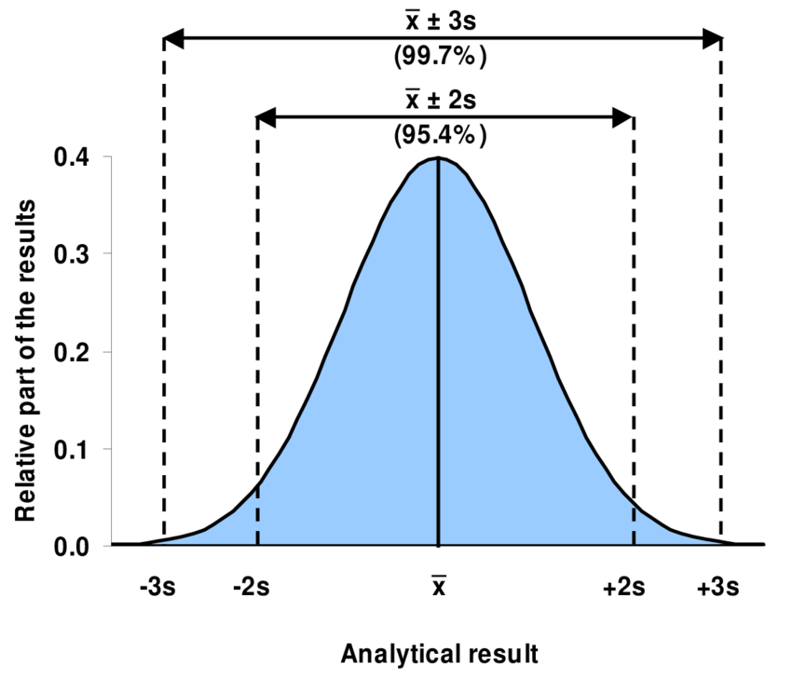
1 Normal Distribution
The normal distribution, also known as the Gaussian distribution, is a bell-shaped and symmetric probability distribution that describes how values of a variable are distributed.
Key Points:
1. Shape
Symmetrical about the mean (centered).
Bell-shaped curve (tall in the middle, tapers at the ends).
Mean = Median = Mode.
2. X-axis (horizontal axis):
Represents the values of the variable (e.g., height, weight, test scores).
The center (peak) is at the mean (μ).
3. Y-axis (vertical axis):
Represents probability density (not actual probabilities).
Tells how likely each value of X is (higher Y = more likely).
4. Parameters
Mean (μ): Determines the center of the distribution.
Standard deviation (σ): Controls the spread (width) of the curve.
Smaller σ = narrower, taller curve.
Larger σ = wider, flatter curve.
5. Empirical Rule (68-95-99.7 Rule):
About 68% of values fall within ±1σ from the mean.
About 95% within ±2σ.
About 99.7% within ±3σ.
6. Probability
The area under the curve represents probabilities.
The total area = 1 (100%).

Slide 7
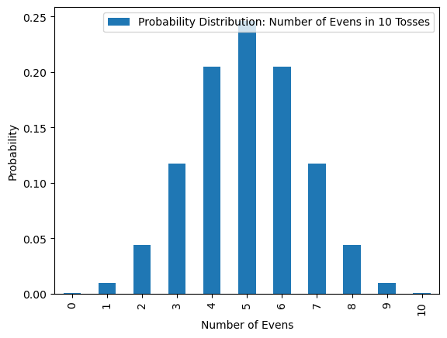
2. Binomial Distribution
The binomial distribution models the number of successes in a fixed number of independent trials, where each trial has two outcomes: Success (1) or Failure (0).
It’s ideal for situations like: flipping a coin, passing/failing an exam, or detecting spam emails.
Key Points:
Shape:
Symmetrical when p = 0.5
Skewed right if p < 0.5
Skewed left if p > 0.5
As n increases, it approaches the normal distribution.
Conditions for Binomial Distribution:
Fixed number of trials (n)
Each trial is independent
Only two outcomes: success or failure
Same probability (p) of success on each trial
X and Y Axis:
➤ X-axis:
Discrete values from 0 to n (number of successes)
➤ Y-axis:
Probability of getting each value of X (success count)
Example:
Suppose you flip a coin 10 times (n = 10), and the probability of heads (success) is 0.5:
X values: 0 to 10 (number of heads)
Y values: probability of getting each number of heads (e.g., 5 heads ≈ highest probability)
A discrete distribution for a fixed number of yes/no trials.
Counts how many times success happens in n tries.

Slide 8
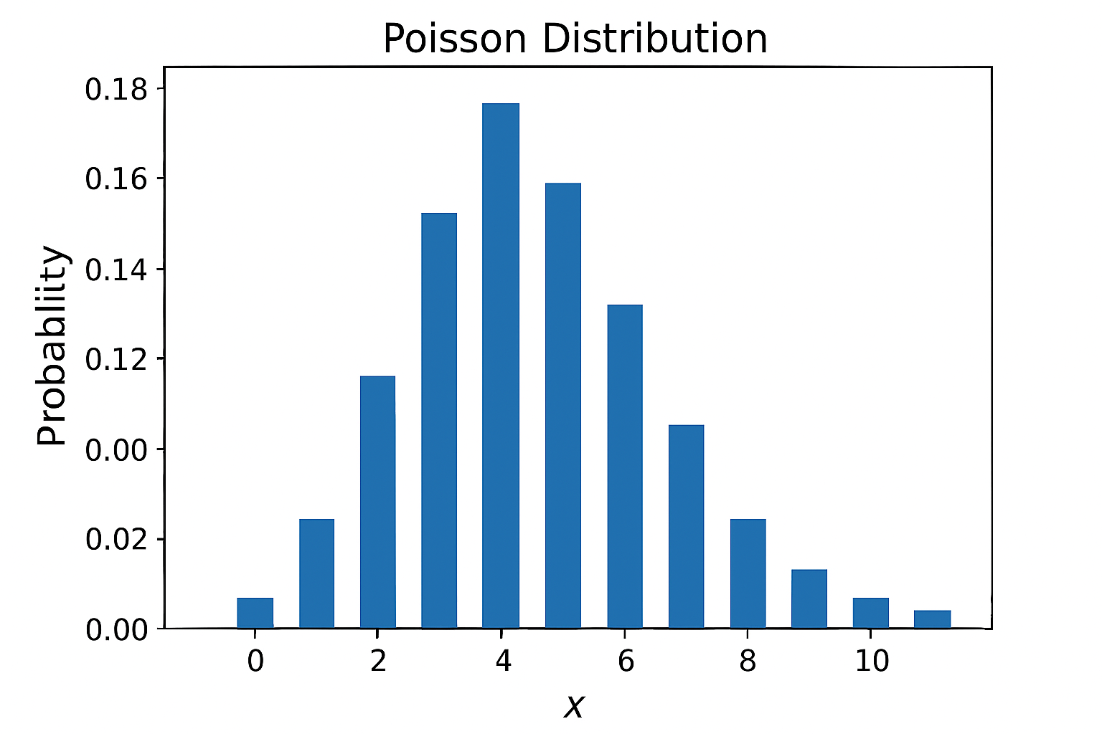
3. Poisson Distribution
The Poisson distribution models the number of events happening in a fixed interval of time or space, where the events occur:
Independently
At a constant average rate (λ)
It’s used when you want to know: “How many times will an event happen?” — like:
Number of customer arrivals per hour
Number of calls to a call center
Number of typos on a page
Key Points:
Shape of the Distribution:
Skewed when λ is small (λ < 10)
Becomes symmetric and bell-shaped as λ increases
Always starts at X = 0 and rises/falls based on λ
Conditions:
Events occur independently
Events happen at a constant rate λ (lambda)
Two events can’t occur at the exact same instant
The number of events in one interval is independent of others
X and Y Axis:
➤ X-axis:
Discrete values: 0, 1, 2, 3, ...
➤ Y-axis:
Probability of exactly X events occurring
A discrete distribution used for counting rare events in a fixed interval.

Slide 9
Summary:
Distribution | Type | Use Case | Plot Shape
Normal | Continuous | Heights, IQ, ML assumptions | Bell-shaped
Binomial | Discrete | Pass/fail, classification | Bar spikes
Poisson | Discrete | Event counts (per time/space) | Skewed bars
Toh aaj humne seekha:
Distributions kya hoti hain
Normal, Binomial aur Poisson ka use Machine Learning mein
Inka plot aur real-world examples

